Slide 1
TSE Setup介绍
BIOS-徐玉进

Slide 2
目录
01
TSE
02
Setup
03
保护模式
Sample Code
虚拟8086模式
系统管理模式

Slide 3
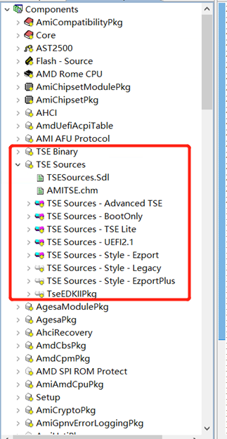
What’s TSE
TSE: Text Setup Environment
POST Logo
Ask Password
Boot manager
Hotkey functionality
SETUP Menu

Slide 4

TSE Flow
DXE phase (Entry point)
White: Flow
Black: eLink, Event
Red: Function name or Comment
MiniSetupApplication()
MinisetupDriverEntryHookHook()
BDS phase
BDS entry
Connect Consoles
AmiPostMgr->Handshake
(Entry PostManagerHandshake())
Draw POST screen
ActivateApplication()
ProcessConOutAvailableHook()
DrawQuietBootLogoHook()
NotificationFunction()
ProcessConInAvailabilityHook()
ProcessConOutAvailableHook()
DrawQuietBootLogoHook()
Check system password
ActivateInput()
ProcessConInAvailabilityHook()
CheckForKeyHook()

Slide 5
TSE Flow
PostManagerHandshake()
PostManagerHandShakeHookHook()
Initial boot option, language and setup data buffer
Delay to check POST hotkey
CheckForKeyHook()
TimeOutLoopHookHook()
Normal
ProcessEnterSetupHook()
Check setup password
ProcessProceedToBootHook()
Setup
MainSetupLoop()
BBS
DoPopup()
DrawPopupMenuHook()
BbsBootHook()

Slide 6
TSE Flow
Draw page border
StyleDrawPageBorder
Setup entry
MainSetupLoop()
Update special item
(Boot order, Language … ect)
SpecialUpdatePageControls
ProcessEnterSetupHook()
Check setup password
Initial control setup item data
Draw Setup item
gPage.Draw()
No
Boot from Boot Override item
Itemaction control
gPage.HandleAction()
Setup menu hotkey
gApplication.HandleAction()
Yes
ProcessProceedToBootNowHook()
ProcessProceedToBootHook()
(! gApp->Quit)
True
_BootLaunchDevicePath()
ReadyToBootEvent
False
False
Modified item need reset
ResetSystem (Cold Reset) PreSystemResetHookHook()
True

Slide 7
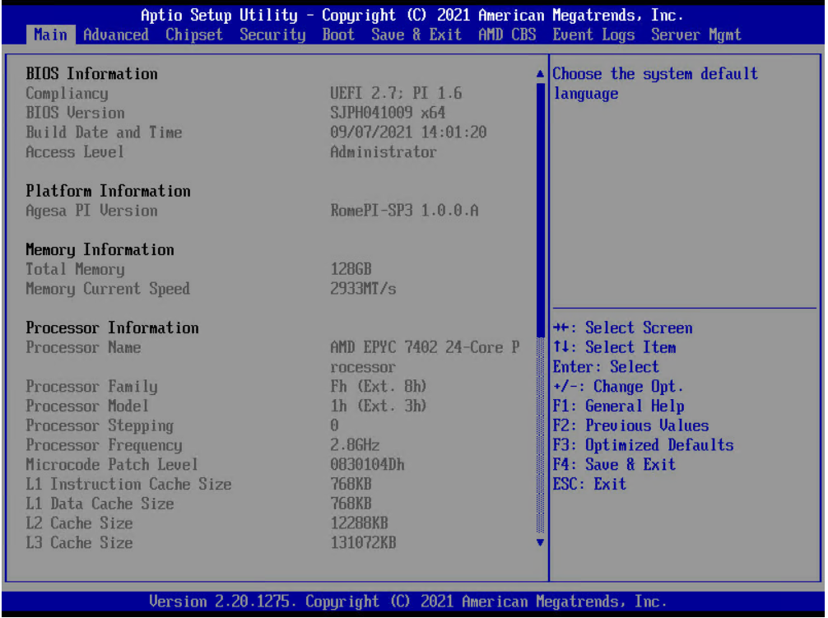

Setup Page
How to Draw the Setup Page

Slide 8
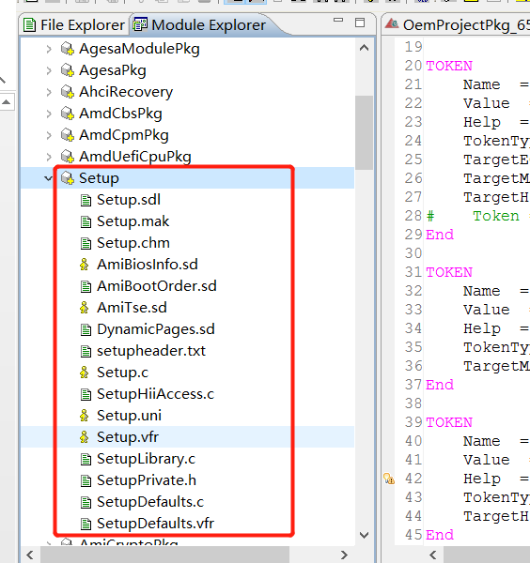
What’s Setup
Compiler VFR, SD and UNI files to Package data.
Add Package data (VFR and UNI files) into Hii Database.
Install callback functions to communicate with user.

Slide 9
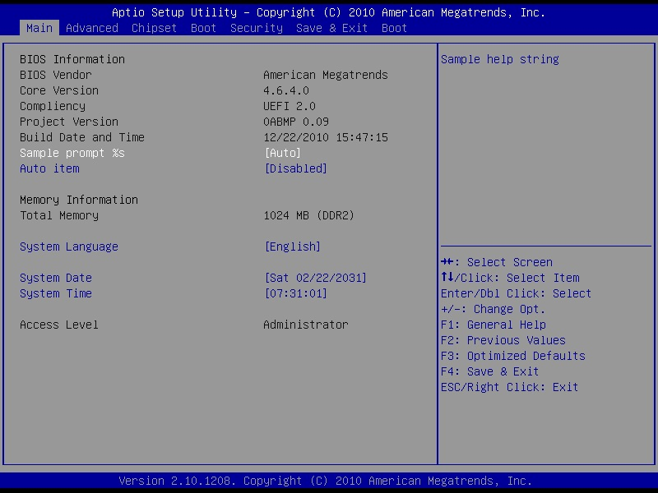
VFR To Setup Utility
TITLE_FRAME
SUBTITLE_FRAME
MAIN_FRAME
HELP_FRAME
formset guid = SETUP_FORM_SET_GUID,
title = STRING_TOKEN(STR_SETUP),
help = STRING_TOKEN(STR_SETUP_HELP),
class = SETUP_FORM_SET_CLASS,
subclass = 0,
goto MAIN_MAIN,
prompt = STRING_TOKEN(STR_MAIN),
help = STRING_TOKEN(STR_EMPTY);
goto ADVANCED_MAIN,
prompt = STRING_TOKEN(STR_ADVANCED),
help = STRING_TOKEN(STR_EMPTY);
goto CHIPSET_MAIN,
prompt = STRING_TOKEN(STR_CHIPSET),
help = STRING_TOKEN(STR_EMPTY);
......
endformset;
NAV_FRAME
Setup.vfr
HELPTITLE_FRAME

Slide 10
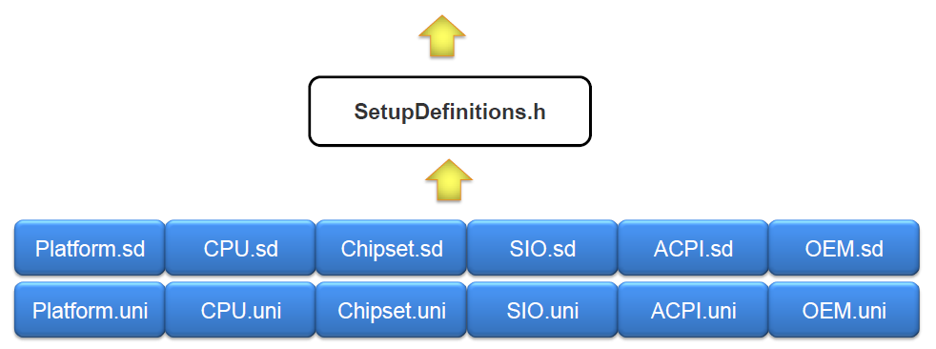
VFR and SD File Relation (1/3)
Setup.vfr

Slide 11
VFR and SD File Relation (2/3)
#define CHIPSET_FORM_SET
#define FORM_SET_TYPEDEF
#include <SetupDefinitions.h>
#undef FORM_SET_TYPEDEF
formset guid = ……,
#define FORM_SET_VARSTORE
#include <SetupDefinitions.h>
#undef FORM_SET_VARSTORE
form formid = …..
#define FORM_SET_ITEM
#include <SetupDefinitions.h>
#undef FORM_SET_ITEM
#ifdef CHIPSET_FORM_SET
#ifdef FORM_SET_VARSTORE
varstore NB_PLATFORM_DATA,
key = AUTO_ID(NB_PLATFORM_DATA_ID),
name = NBPlatformData,
guid = SETUP_GUID;
#endif //FORM_SET_VARSTORE
#ifdef FORM_SET_ITEM
text
help = STRING_TOKEN(STR_SA_BRIDGE_HELP),
text = STRING_TOKEN(STR_SA_BRIDGE_NAME),
text = STRING_TOKEN(STR_SA_BRIDGE_VALUE),
flags = 0, key = 0;
#endif
#endif
VFR file Sample
SD file Sample

Slide 12
VFR and SD File Relation (3/3)
Combine VFR and SD files
#define CHIPSET_FORM_SET
#define FORM_SET_TYPEDEF
#include <SetupDefinitions.h>
#undef FORM_SET_TYPEDEF
formset guid = ……,
varstore NB_PLATFORM_DATA,
key = AUTO_ID(NB_PLATFORM_DATA_ID),
name = NBPlatformData,
guid = SETUP_GUID;
form formid = …..
text
help = STRING_TOKEN(STR_SA_BRIDGE_HELP),
text = STRING_TOKEN(STR_SA_BRIDGE_NAME),
text = STRING_TOKEN(STR_SA_BRIDGE_VALUE),
flags = 0, key = 0;

Slide 13
SETUP_DATA_DEFINITION
SD file:
#ifdef SETUP_DATA_DEFINITION
UINT8 AcpiAuto;
UINT8 ForceToAcpi1;
#endif
GenericSetupDataDefinition.h
typedef struct{
UINT8 Numlock;
#define SETUP_DATA_DEFINITION
#include <SetupDefinitions.h>
#undef SETUP_DATA_DEFINITION
} SETUP_DATA;
SetupDefinitions.h:
#include<AmiModulePkg/FastBoot/FastBoot.sd>
#include<AmiModulePkg/ACPI/ACPI.sd>
GenericSetupDataDefinition.h
typedef struct{
UINT8 Numlock;
UINT8 AcpiAuto;
UINT8 ForceToAcpi1;
....
} SETUP_DATA;

Slide 14

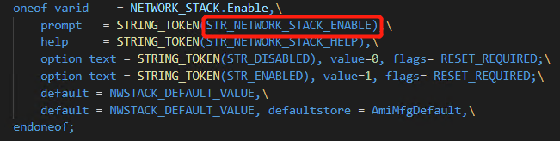

VFR and UNI File Relation
#string STR_NETWORK_STACK_ENABLE #language zh-chs "网络栈"
#language eng "Network Stack"
VFR Oneof Sample
UNI String Sample

Slide 15
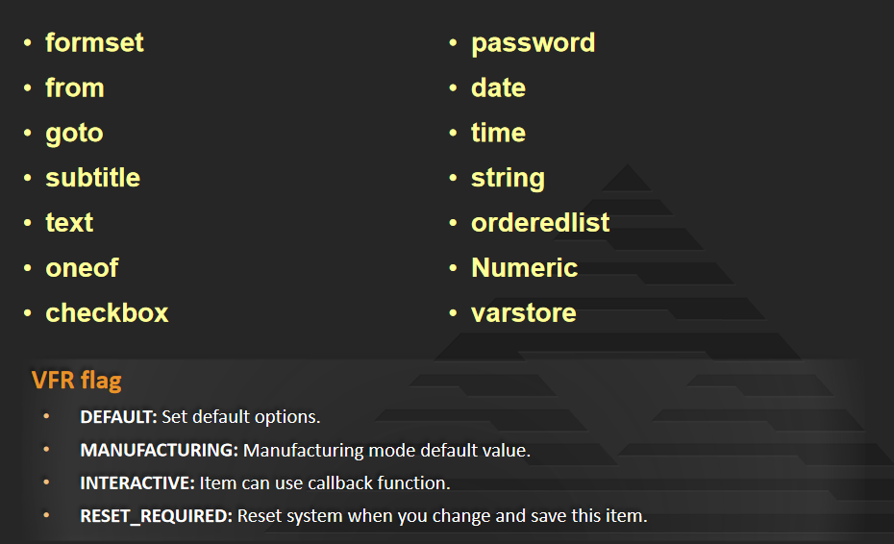
VFR Item Type and Flag

Slide 16
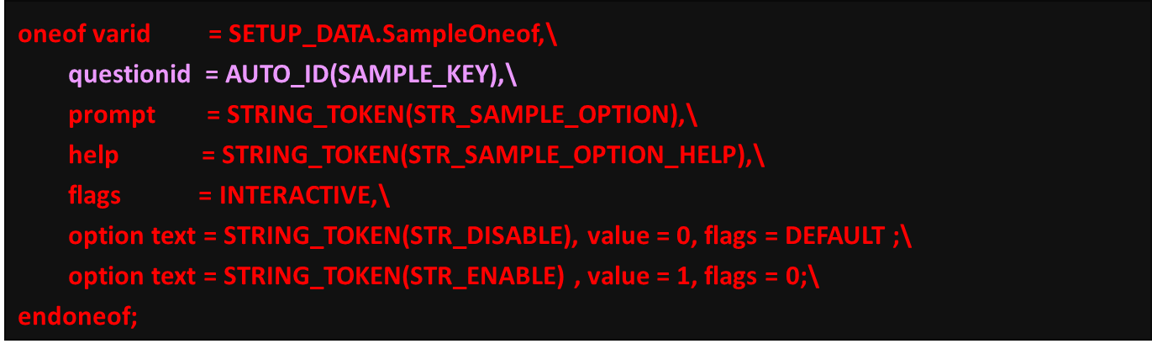
QuestionId Parameter
QuestionId:
QuestionId is same to the key value.
Oneof item only use questionid, can’t use key, the other item can use both questionId and key.

Slide 17
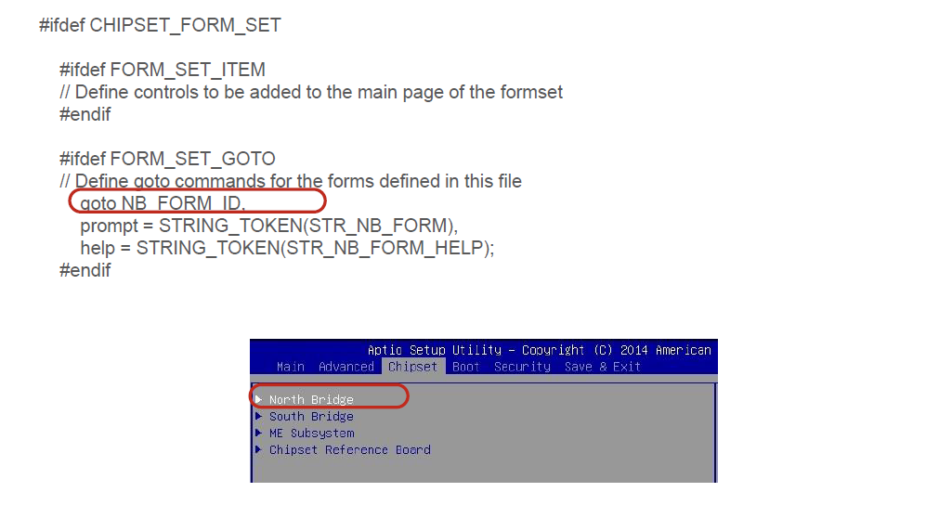
Setup Option - goto

Slide 18
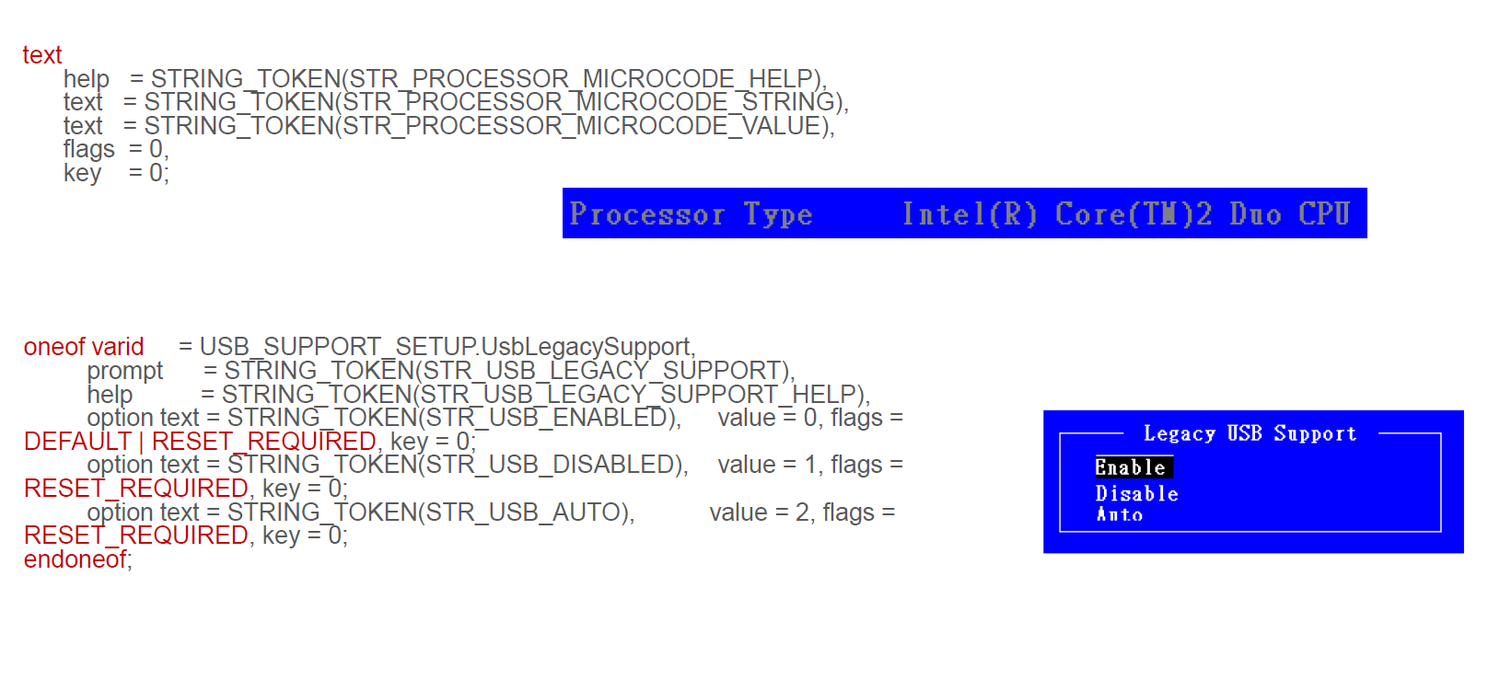
Setup Option - text & oneof

Slide 19
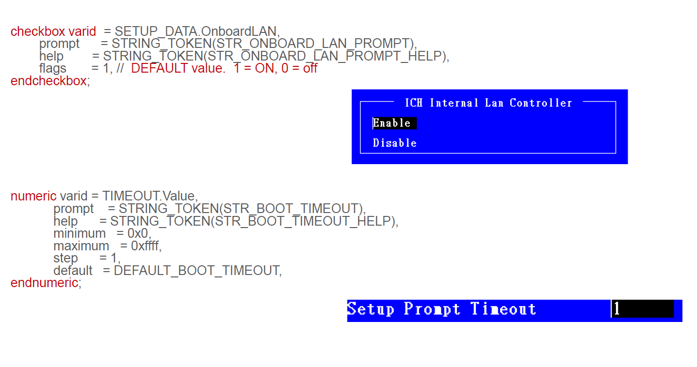
Setup Option - checkbox & numeric

Slide 20
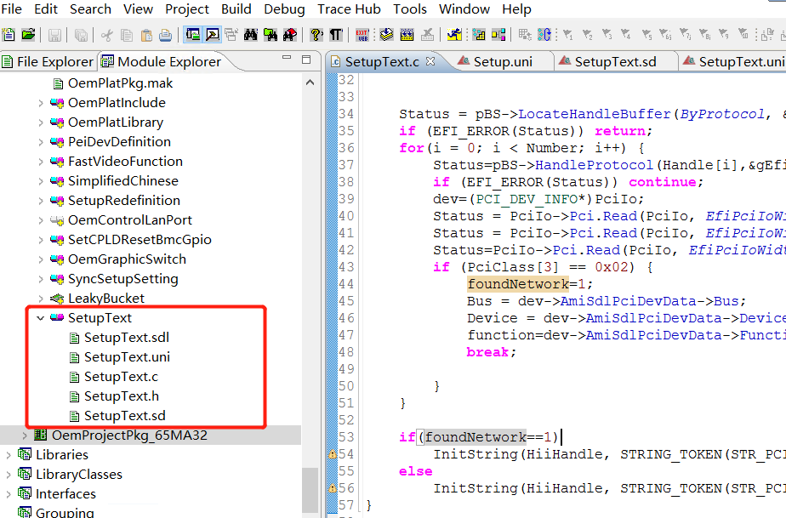
Sample Code

Slide 21
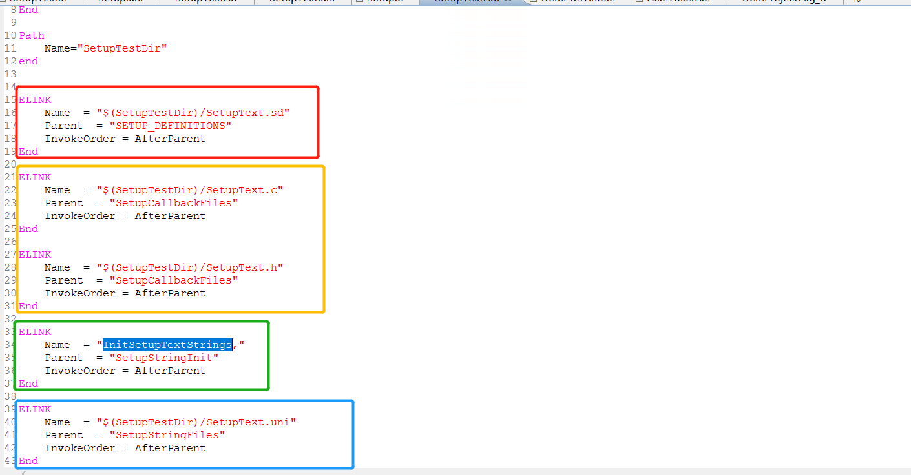
Sample Code

Slide 22
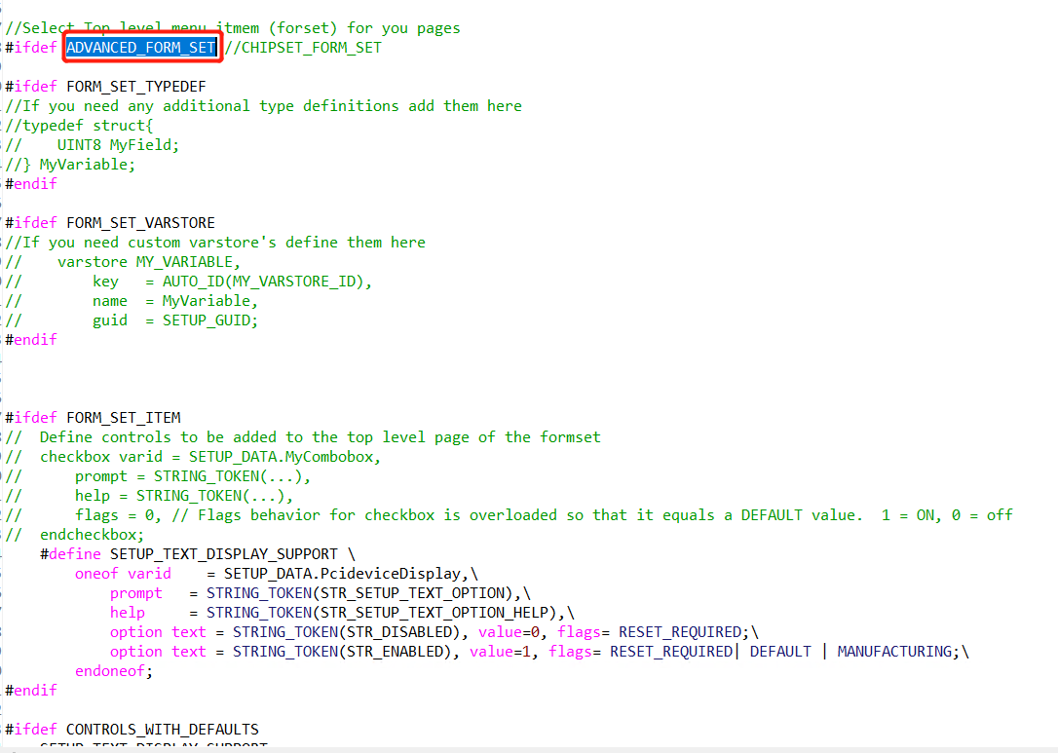
Sample Code

Slide 23
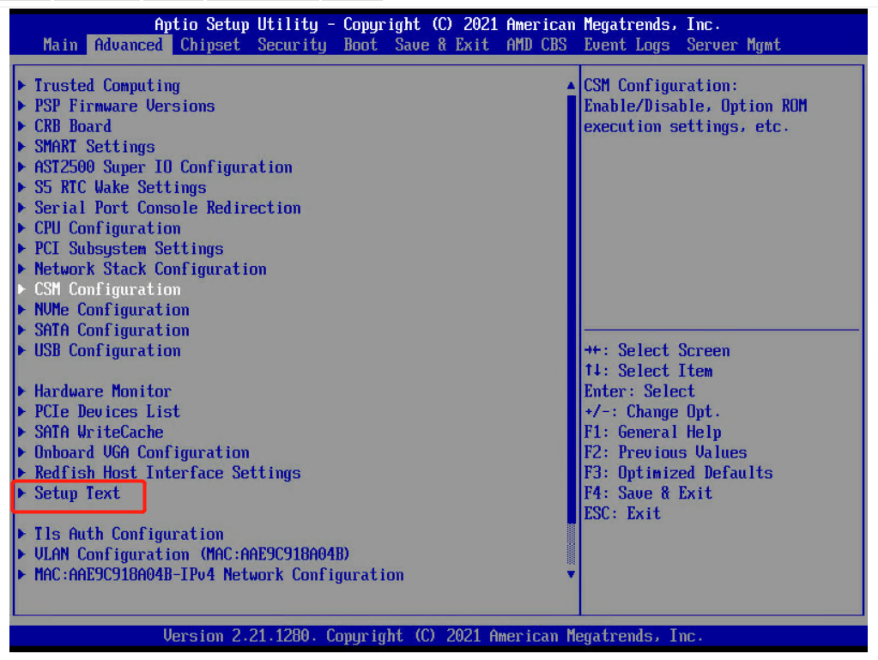
Sample Code

Slide 24
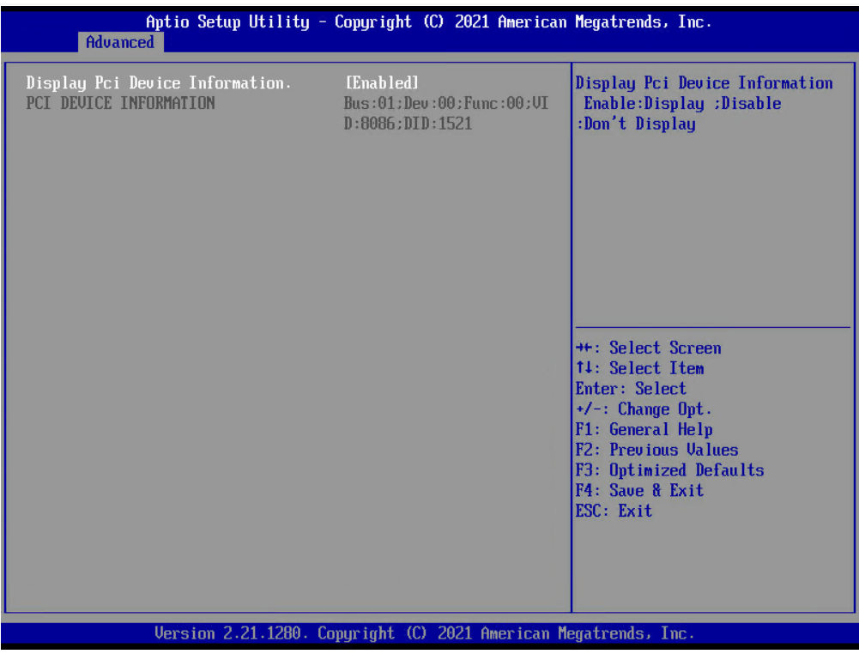
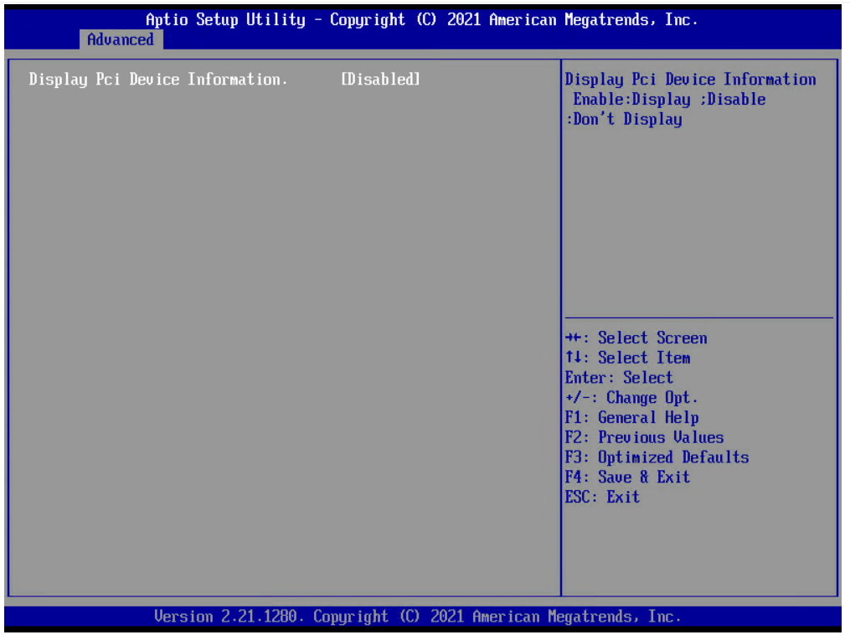
Sample Code

Slide 25
作业
在Setup界面的Advanced的页面下增加一个自己的页面，该页面包含以下的内容：
控制PCI设备信息显示的选项开关，当设置为Enabled时，显示下面PCI设备的相关信息，当设置为Disabled时，将PCI设备的相关信息进行影藏
显示当前机器上识别到的第一张网卡的Bus 、Dev、 Func 以及VID和DID相关信息；如果在此机器上没有PCIE网卡，则显示没有找到PCIE网卡设备

Slide 26
谢谢观看

